Slide 1
Simplex Stern tube systems
SKF Marine GmbH Hamburg, Germany
SKF Marine experts: click here
Frank Kania – Frank.Kania@skf.com
Karl-Heinz Schmidtke – Karl-Heinz.Schmidtke@skf.com
Karsten Thomm – Karsten.Thomm@skf.com
Marcus Grabe – Marcus.Grabe@skf.com
Uwe Hawer – Uwe.Hawer@skf.com

Slide 2
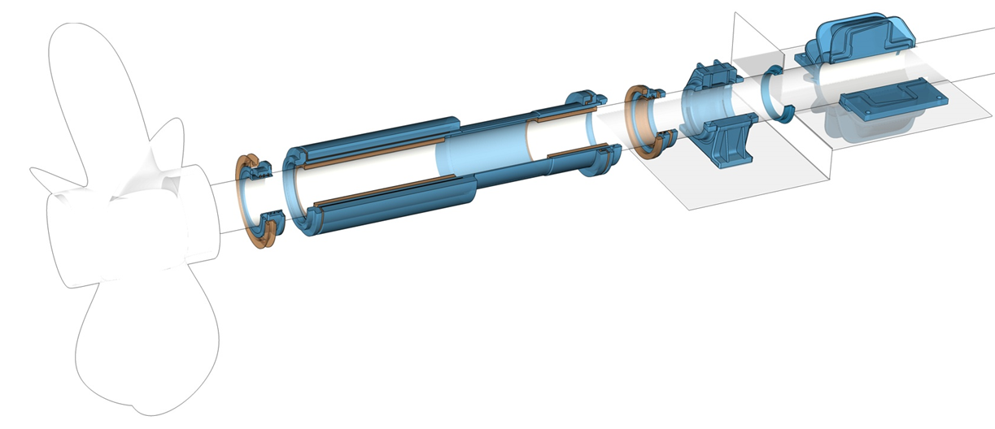
Application and general description
Application
Oil or water-lubricated stern tube designed for
  conventional propeller shaft lines
  vessels with one or two shaft struts
General description
Complete stern tube system
Turnkey solution ready for installation
Certified by all major classification societies
Customized modular design for all vessel types and sizes
Delivered as a plug and play solution fully assembled and tested

Slide 3
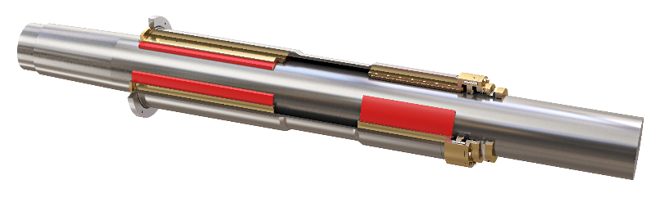
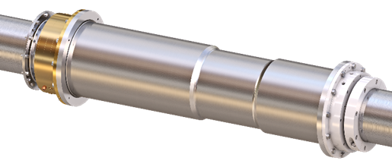
Configuration
Conventional oil-lubricated stern tube systems
on mineral oil base
  with a special non polluting Airspace aft seal
  classified as a Non-Oil-to-Sea-Interface in the sense of VGP 2013
on biodegradable oil base (EAL)
BlueRun water-lubricated stern tube systems
Closed stern tube system on fresh water base with continuous water circulation
Open stern tube system on sea water base with continuous water flushing
BlueRun bearing bush
Simplex
water-lubricated forward seal
Simplex Airspace
Simplex
oil-lubricated forward seal

Slide 4
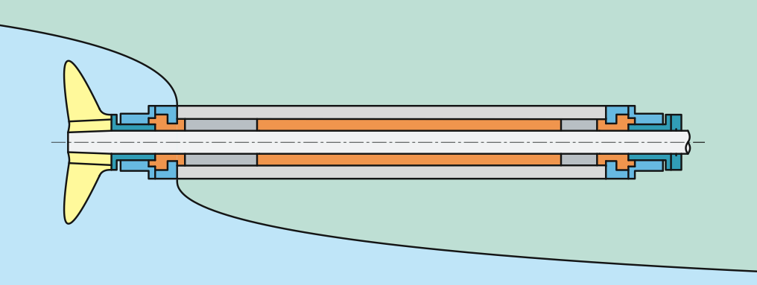
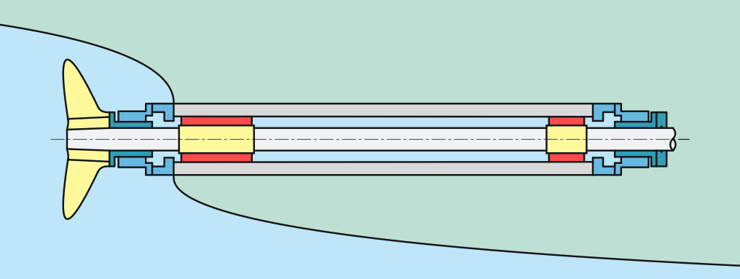
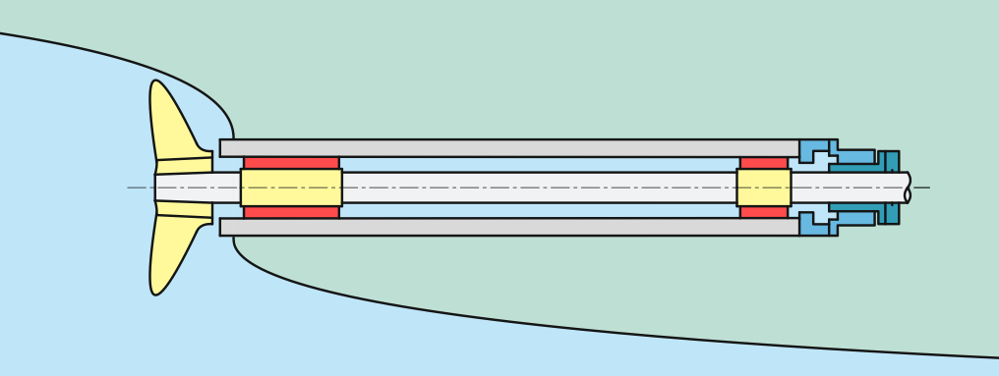
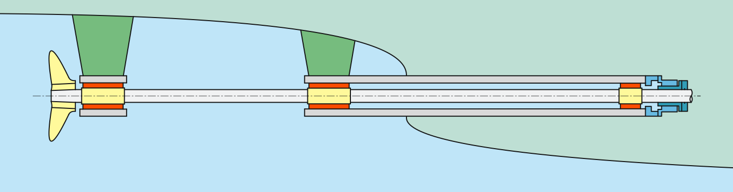
Stern tube designs – Oil / water lubricated
Closed stern tube with fwd. and aft seal
with mineral or bio-degradable oil filling
with standard aft seal or Airspace (non oil to sea interface seal)
Closed stern tube with fwd. and aft seal
with fresh water filling
with anti-corrosive protection additive
Open stern tube with fwd. seal
stern tube with seawater access from the aft
water flushing from inside to outside
Open stern tube with one or two shaft struts
open stern tube filled with sea water
water flushing in the stern tube from inside to outside
shaft strut with sea water lubricated bearing

Slide 5
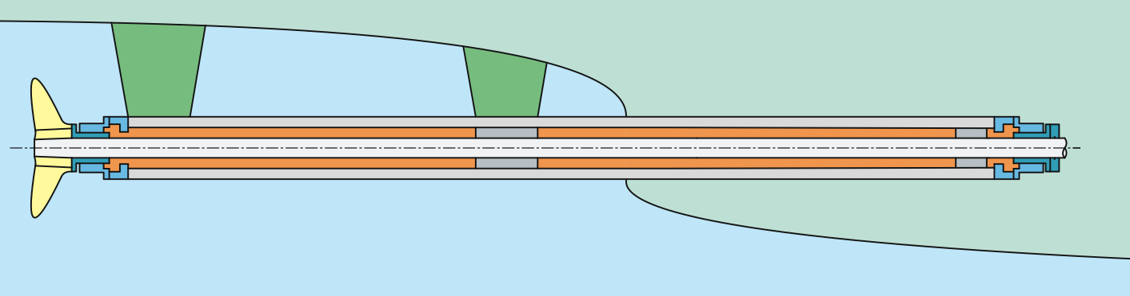
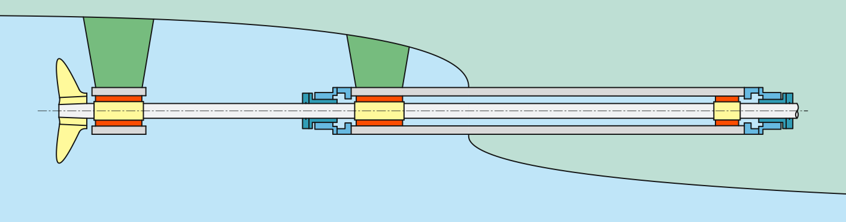
Stern tube designs – Oil / water lubricated
Closed stern tube with fwd. and aft seal with one or two shaft struts
stern tube completely enclosed
  with mineral or bio-degradable oil filling
  with standard aft seal or Airspace (a non oil to sea interface seal) alternative
stern tube completely enclosed
  with fresh water filling
  with anti-corrosive protection additive
Closed stern tube and open bearing at the shaft strut
closed stern tube filled with oil or fresh water
shaft strut with sea water lubricated bearing

